Slide 1
Mining Massive Datasets
Wu-Jun Li
Department of Computer Science and Engineering
Shanghai Jiao Tong University
Lecture 8: Clustering

Slide 2
Outline
Introduction
Hierarchical Clustering
Point Assignment based Clustering
Evaluation

Slide 3
The Problem of Clustering
Introduction
Given a set of points, with a notion of distance between points, group the points into some number of clusters, so that
  Members of a cluster are as close to each other as possible
  Members of different clusters are dissimilar
Distance measure
  Euclidean, Cosine, Jaccard, edit distance, …

Slide 4
Example
Introduction
x
xx x
x x
x x x
x
x x x
x
x
x x
x x x x
x x x x
x x x
x x
x x
x x x x
x x x
x
x

Slide 5
Application: SkyCat
Introduction
A catalog of 2 billion “sky objects” represents objects by their radiation in 7 dimensions (frequency bands).
Problem: cluster into similar objects, e.g., galaxies, nearby stars, quasars, etc.
Sloan Sky Survey is a newer, better version.

Slide 6
Example: Clustering CD’s
(Collaborative Filtering)
Introduction
Intuitively: music divides into categories, and customers prefer a few categories.
  But what are categories really?
Represent a CD by the customers who bought it.
  A CD’s point in this space is (x₁, x₂,…, x_{k}), where x_{i} = 1 iff the i ^{th} customer bought the CD.
Similar CD’s have similar sets of customers, and vice-versa.

Slide 7
Example: Clustering Documents
Introduction
Represent a document by a vector (x₁, x₂,…, x_{k}), where x_{i} = 1 iff the i ^{th} word (in some order) appears in the document.
  It actually doesn’t matter if k is infinite; i.e., we don’t limit the set of words.
Documents with similar sets of words may be about the same topic.

Slide 8
Example: DNA Sequences
Introduction
Objects are sequences of {C,A,T,G}.
Distance between sequences is edit distance, the minimum number of inserts and deletes needed to turn one into the other.

Slide 9
Cosine, Jaccard, and Euclidean Distances
Introduction
As with CD’s, we have a choice when we think of documents as sets of words or shingles:
  Sets as vectors: measure similarity by the cosine distance.
  Sets as sets: measure similarity by the Jaccard distance.
  Sets as points: measure similarity by Euclidean distance.

Slide 10
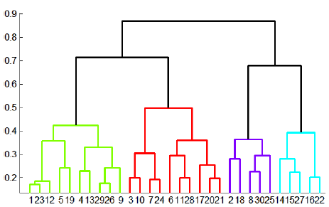
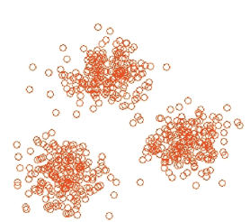
Clustering Algorithms
Introduction
Hierarchical algorithms
  Agglomerative (bottom-up)
    Initially, each point in cluster by itself.
    Repeatedly combine the two “nearest” clusters into one.
  Divisive (top-down)
Point Assignment
  Maintain a set of clusters.
  Place points into their “nearest” cluster.

Slide 11
Outline
Introduction
Hierarchical Clustering
Point Assignment based Clustering
Evaluation

Slide 12
Hierarchical Clustering
Hierarchical Clustering
Two important questions:
  How do you represent a cluster of more than one point?
  How do you determine the “nearness” of clusters?

Slide 13
Hierarchical Clustering – (2)
Hierarchical Clustering
Key problem: as you build clusters, how do you represent the location of each cluster, to tell which pair of clusters is closest?
Euclidean case: each cluster has a centroid = average of its points.
  Measure inter-cluster distances by distances of centroids.

Slide 14
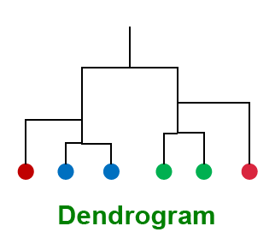
Example
Hierarchical Clustering
(5,3)
o
(1,2)
o
o (2,1) o (4,1)
o (0,0) o
(5,0)
x (1.5,1.5)
x (4.7,1.3)
x (1,1)
x (4.5,0.5)
o : data point
x : centroid

Slide 15
And in the Non-Euclidean Case?
Hierarchical Clustering
The only “locations” we can talk about are the points themselves.
  I.e., there is no “average” of two points.
Approach 1: clustroid = point “closest” to other points.
  Treat clustroid as if it were centroid, when computing intercluster distances.

Slide 16
“Closest” Point?
Hierarchical Clustering
Possible meanings:
  Smallest maximum distance to the other points.
  Smallest average distance to other points.
  Smallest sum of squares of distances to other points.
  Etc., etc.

Slide 17
Example
Hierarchical Clustering
clustroid
1
2
6
4
3
5
clustroid
intercluster
distance

Slide 18
Other Approaches to Defining “Nearness” of Clusters
Hierarchical Clustering
Approach 2: intercluster distance = minimum of the distances between any two points, one from each cluster.
Approach 3: Pick a notion of “cohesion” of clusters, e.g., maximum distance from the clustroid.
  Merge clusters whose union is most cohesive.

Slide 19
Cohesion
Hierarchical Clustering
Approach 1: Use the diameter of the merged cluster = maximum distance between points in the cluster.
Approach 2: Use the average distance between points in the cluster.
Approach 3: Use a density-based approach: take the diameter or average distance, e.g., and divide by the number of points in the cluster.
  Perhaps raise the number of points to a power first, e.g., square-root.

Slide 20
Outline
Introduction
Hierarchical Clustering
Point Assignment based Clustering
Evaluation

Slide 21
k – Means Algorithm(s)
Point Assignment
Assumes Euclidean space.
Start by picking k, the number of clusters.
Select k points {s₁, s₂,… s_{K}} as seeds.
  Example: pick one point at random, then k -1 other points, each as far away as possible from the previous points.
Until clustering converges (or other stopping criterion):
  For each point x_{i}:
    Assign x_{i} to the cluster c_{j} such that dist(x_{i}, s_{j}) is minimal.
  For each cluster c_{j}
    s_{j} = μ(c_{j}) where μ(c_{j}) is the centroid of cluster c_{j}

Slide 22
k-Means Example (k=2)
Point Assignment
Pick seeds
Reassign clusters
Compute centroids
Reassign clusters
x
x
x
Compute centroids
x
x
x
Reassign clusters
Converged!

Slide 23
Termination conditions
Point Assignment
Several possibilities, e.g.,
  A fixed number of iterations.
  Point assignment unchanged.
  Centroid positions don’t change.

Slide 24
Getting k Right
Point Assignment
Try different k, looking at the change in the average distance to centroid, as k increases.
Average falls rapidly until right k, then changes little.
Best value
of k
Average
distance to
centroid
k

Slide 25
Example: Picking k
Point Assignment
x
xx x
x x
x x x
x
x x x
x
Too few;
many long
distances
to centroid.
x
x x
x x x x
x x x x
x x x
x x
x x
x x x x
x x x
x
x

Slide 26
Example: Picking k
Point Assignment
x
xx x
x x
x x x
x
x x x
x
x
Just right;
distances
rather short.
x x
x x x x
x x x x
x x x
x x
x x
x x x x
x x x
x
x

Slide 27
Example: Picking k
Point Assignment
Too many;
little improvement
in average
distance.
x
xx x
x x
x x x
x
x x x
x
x
x x
x x x x
x x x x
x x x
x x
x x
x x x x
x x x
x
x

Slide 28
BFR Algorithm
Point Assignment
BFR (Bradley-Fayyad-Reina) is a variant of k-means designed to handle very large (disk-resident) data sets.
It assumes that clusters are normally distributed around a centroid in a Euclidean space.
  Standard deviations in different dimensions may vary.

Slide 29
BFR – (2)
Point Assignment
Points are read one main-memory-full at a time.
Most points from previous memory loads are summarized by simple statistics.
To begin, from the initial load we select the initial k centroids by some sensible approach.

Slide 30
Initialization: k -Means
Point Assignment
Possibilities include:
  Take a small random sample and cluster optimally.
  Take a sample; pick a random point, and then k – 1 more points, each as far from the previously selected points as possible.

Slide 31
Three Classes of Points
Point Assignment
discard set (DS):
  points close enough to a centroid to be summarized.
compressed set (CS):
  groups of points that are close together but not close to any centroid.
  They are summarized, but not assigned to a cluster.
retained set (RS):
  isolated points.

Slide 32
Summarizing Sets of Points
Point Assignment
For each cluster, the discard set is summarized by:
  The number of points, N.
  The vector SUM, whose i ^{th} component is the sum of the coordinates of the points in the i ^{th} dimension.
  The vector SUMSQ, whose i ^{th} component is the sum of squares of coordinates in i ^{th} dimension.

Slide 33
Comments
Point Assignment
2d + 1 values represent any number of points.
  d = number of dimensions.
Averages in each dimension (centroid coordinates) can be calculated easily as SUM_{i} /N.
  SUM_{i} = i ^{th} component of SUM.

Slide 34
Comments – (2)
Point Assignment
Variance of a cluster’s discard set in dimension i can be computed by: (SUMSQ_{i} /N ) – (SUM_{i} /N )²
And the standard deviation is the square root of that.
The same statistics can represent any compressed set.

Slide 35
“Galaxies” Picture
Point Assignment
Points in
the RS
Compressed sets.
Their points are in
the CS.
A cluster. Its points
are in the DS.
The centroid

Slide 36
Processing a “Memory-Load” of Points
Point Assignment
Find those points that are “sufficiently close” to a cluster centroid; add those points to that cluster and the DS.
Use any main-memory clustering algorithm to cluster the remaining points and the old RS.
  Clusters go to the CS; outlying points to the RS.

Slide 37
Processing – (2)
Point Assignment
Adjust statistics of the clusters to account for the new points.
  Add N’s, SUM’s, SUMSQ’s.
Consider merging compressed sets in the CS.
If this is the last round, merge all compressed sets in the CS and all RS points into their nearest cluster.

Slide 38
A Few Details . . .
Point Assignment
How do we decide if a point is “close enough” to a cluster that we will add the point to that cluster?
How do we decide whether two compressed sets deserve to be combined into one?

Slide 39
How Close is Close Enough?
Point Assignment
We need a way to decide whether to put a new point into a cluster.
BFR suggest two ways:
  The Mahalanobis distance is less than a threshold.
  Low likelihood of the currently nearest centroid changing.

Slide 40
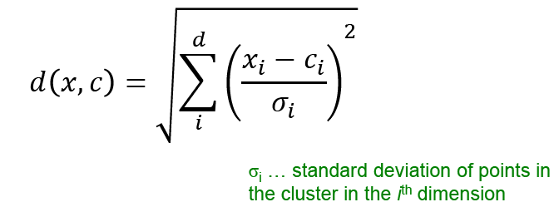
Mahalanobis Distance
Point Assignment
Normalized Euclidean distance from centroid.
For point (x₁,…,x_{d}) and centroid (c₁,…,c_{d}):
  Normalize in each dimension: y_{i} = (x_{i} -c_{i})/σ_{i}
  Take sum of the squares of the y_{i} ’s.
  Take the square root.

Slide 41

Mahalanobis Distance – (2)
Point Assignment
If clusters are normally distributed in d dimensions, then after transformation, one standard deviation = .
  I.e., 70% of the points of the cluster will have a Mahalanobis distance < .
Accept a point for a cluster if its M.D. is < some threshold, e.g. 4 standard deviations.

Slide 42
Picture: Equal M.D. Regions
Point Assignment
2σ
σ

Slide 43
Should Two CS Subclusters Be Combined?
Point Assignment
Compute the variance of the combined subcluster.
  N, SUM, and SUMSQ allow us to make that calculation quickly.
Combine if the variance is below some threshold.
Many alternatives: treat dimensions differently, consider density.

Slide 44
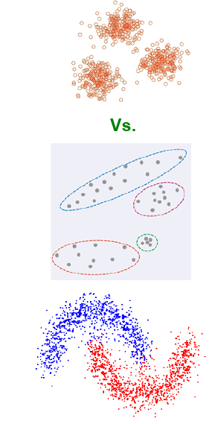
The CURE Algorithm
Point Assignment
Problem with BFR/k -means:
  Assumes clusters are normally distributed in each dimension.
  And axes are fixed – ellipses at an angle are not OK.
CURE (Clustering Using REpresentatives):
  Assumes a Euclidean distance.
  Allows clusters to assume any shape.

Slide 45
Example: Stanford Faculty Salaries
Point Assignment
h
h
h
e
e
e
h
e
e
e
h
e
e
e
e
h
salary
e
h
h
h
h
h
h
h
age

Slide 46
Starting CURE
Point Assignment
Pick a random sample of points that fit in main memory.
Cluster these points hierarchically – group nearest points/clusters.
For each cluster, pick a sample of points, as dispersed as possible.
From the sample, pick representatives by moving them (say) 20% toward the centroid of the cluster.

Slide 47
Example: Initial Clusters
Point Assignment
h
h
h
e
e
e
h
e
e
e
h
e
e
e
e
h
salary
e
h
h
h
h
h
h
h
age

Slide 48
Example: Pick Dispersed Points
Point Assignment
h
h
h
e
e
e
h
e
e
e
h
e
e
e
e
h
salary
e
Pick (say) 4
remote points
for each
cluster.
h
h
h
h
h
h
h
age

Slide 49
Example: Pick Dispersed Points
Point Assignment
h
h
h
e
e
e
h
e
e
e
h
e
e
e
e
h
salary
e
Move points
(say) 20%
toward the
centroid.
h
h
h
h
h
h
h
age

Slide 50
Finishing CURE
Point Assignment
Now, visit each point p in the data set.
Place it in the “closest cluster.”
  Normal definition of “closest”: that cluster with the closest (to p ) among all the sample points of all the clusters.

Slide 51
Outline
Introduction
Hierarchical Clustering
Point Assignment based Clustering
Evaluation

Slide 52
What Is A Good Clustering?
Evaluation
Internal criterion: A good clustering will produce high quality clusters in which:
  the intra-class (that is, intra-cluster) similarity is high
  the inter-class similarity is low
  The measured quality of a clustering depends on both the point representation and the similarity measure used

Slide 53
External criteria for clustering quality
Evaluation
Quality measured by its ability to discover some or all of the hidden patterns or latent classes in gold standard data
Assesses a clustering with respect to ground truth … requires labeled data
Assume documents with C gold standard classes, while our clustering algorithms produce K clusters, ω₁, ω₂, …, ω_{K} with n_{i} members.

Slide 54

External Evaluation of Cluster Quality
Evaluation
Simple measure: purity, the ratio between the dominant class in the cluster π_{i} and the size of cluster ω_{i}
Biased because having n clusters maximizes purity
Others are entropy of classes in clusters (or mutual information between classes and clusters)

Slide 55
Purity example
Evaluation
• •
• •
• •
• •
• •
• •
• •
• •
•
Cluster I
Cluster II
Cluster III
Cluster I: Purity = 1/6 (max(5, 1, 0)) = 5/6
Cluster II: Purity = 1/6 (max(1, 4, 1)) = 4/6
Cluster III: Purity = 1/5 (max(2, 0, 3)) = 3/5

Slide 56
Rand Index measures between pair decisions. Here RI = 0.68
Evaluation
Number of points | Same Cluster in clustering | Different Clusters in clustering
Same class in ground truth | A=20 | C=24
Different classes in ground truth | B=20 | D=72

Slide 57
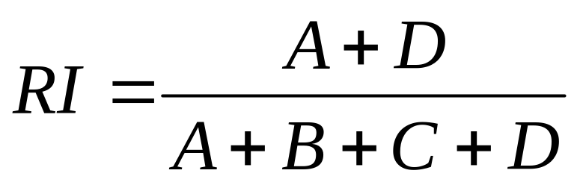
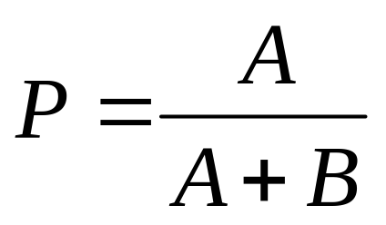
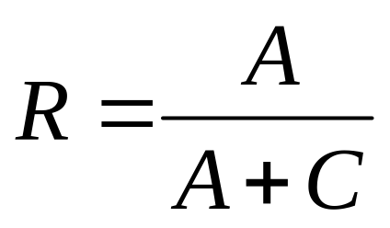
Rand index and Cluster F-measure
Evaluation
Compare with standard Precision and Recall:
People also define and use a cluster F-measure, which is probably a better measure.

Slide 58
Final word and resources
In clustering, clusters are inferred from the data without human input (unsupervised learning)
However, in practice, it’s a bit less clear: there are many ways of influencing the outcome of clustering: number of clusters, similarity measure, representation of points, . . .

Slide 59
More Information
Christopher D. Manning, Prabhakar Raghavan, and Hinrich Schütze. Introduction to Information Retrieval. Cambridge University Press, 2008.
  Chapter 16, 17

Slide 60
Acknowledgement
Slides are from
  Prof. Jeffrey D. Ullman
  Dr. Anand Rajaraman
  Dr. Jure Leskovec
  Prof. Christopher D. Manning

